Slide 1


Global Sales Data Analysis
Data-Driven Insights for Business Decisions
Presented by :
Rawan Dowydar – Ali Khalaf
Date : 17 May 2025

Slide 2

Problem: The company struggles to quickly analyze sales and order data, which affects business decisions.
Proposed Solution: An interactive Power BI dashboard that organizes data by time, location, and product line for faster, more informed decision-making.
Unique Value Proposition: A unified dashboard that simplifies complex data into an easy-to-use interface, allowing real-time insights and deep performance analysis across dimensions.

Slide 3


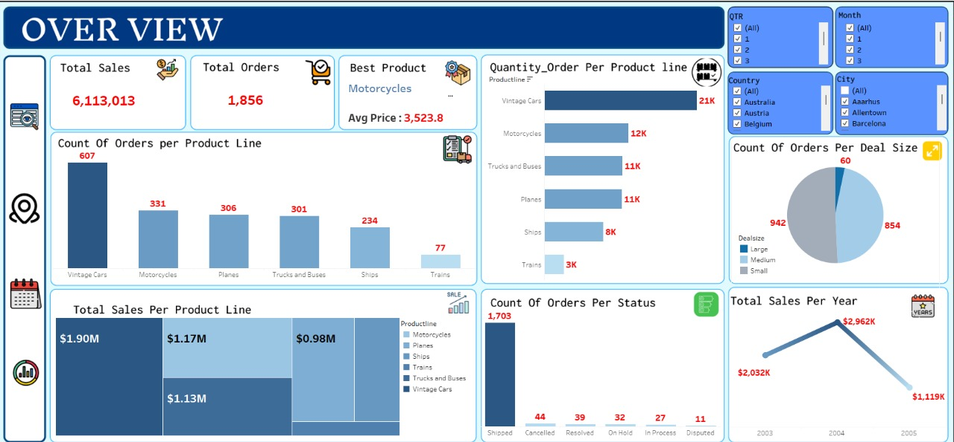
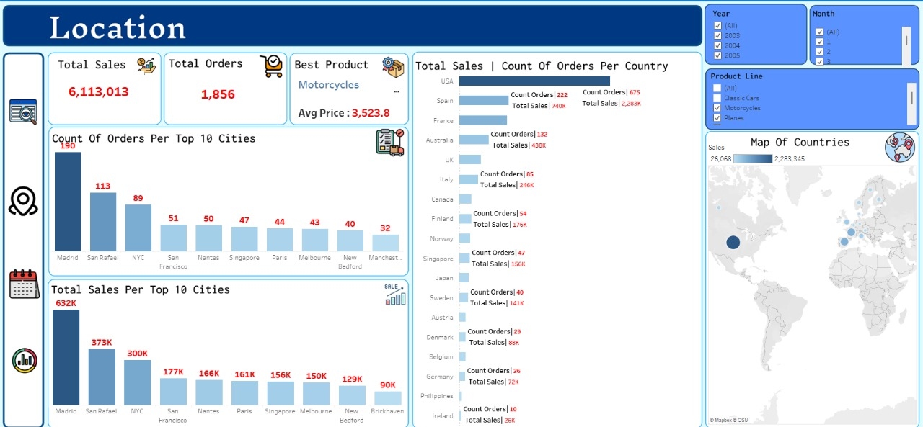
Key User Interfaces:
Overview Page
Analysis By Date
Location Dashboard
Select filters (year, product line, country).
View overall performance stats.
Explore detailed visuals by month, location, and product.
User Journey:

Slide 4

Target Users:
Managers
Sales Teams
Financial Analysts
Key Features:
Sales trends by month /year
Country and city breakdowns
MSRP vs actual sales comparisons
How it Solves Problems:
Identifies best –performing products
Reveals high/low sales regions
Assists in pricing and inventory strategies

Slide 5

Total Sales : 6,113,013
Total Orders : 1,856
Best Product : Motorcycles (1.90M sales )
Top Product Line : Vintage Cars ( 607 orders)

Slide 6
Top Country in Sales : USA (2.28M)
Top City in Sales : Madrid (373K)
Top City in Orders : Madrid (113 orders )

Slide 7
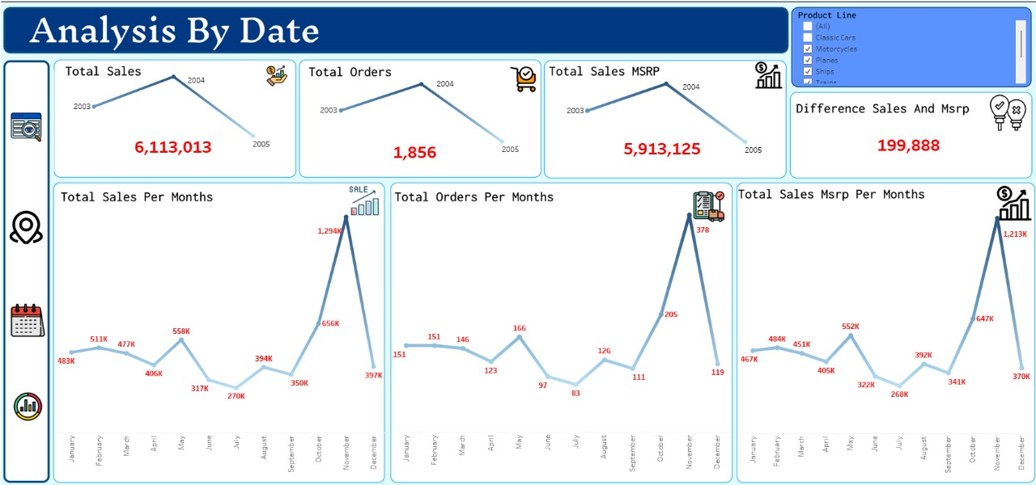
Total Sales in 2003 – 2005 : 6,113,013
Highest Monthly Sales : November
Difference from MSRP : 199,888

Slide 8

Accurate sales analysis for better decision – making
Cost reduction and profit increase
Clear visibility into product performance across countries

Slide 9
The dashboard provides a comprehensive solution for sales analysis
Ready to answer any questions

Slide 10







Project Team Roles
Rawan Dowydar
Reham Gad
Ahmed Ashraf
Taha ALsaeid
Ali Khalaf
Ali Khalaf
Analysis questions
Databases Modeling
Collecting Date
Exploratory analysis
Data cleaning and preprocessing
Visualization and dashboard

Slide 11


Do you have any questions or feedback?
Thank You !
😇
Ask Questions
Email : aliabdalstaar2@gmail.com
📞 Phone: 01127132997

